Slide 1

Features, Scenarios and Stories
Fatemeh Riahi
Based on Ian Sommerville

Slide 2
Overview
Importance of features in product design
How to make list of features by making personas, scenarios.
In class group exercise!

Slide 3

Key component in product designs
Business needs that are not met by current product
Dissatisfaction with existing product
Changes in technologies
Notes:
There are three factors that drive the design of software products
Business and consumer needs that are not met by current products
Dissatisfaction with existing business or consumer software products
Changes in technology that make completely new types of product possible
In the early stage of product development, you are trying to understand, what product features would be useful to users, and what they like and dislike about the products that they use.

Slide 4
Software Features
Fragments of functionality:
  Print, change background, sing out
Before anything, we need to create a list of features
Feature list should be starting point of product design.
Notes:
A feature is a fragment of functionality such as a ‘print’ feature, a ‘change background feature’, a ‘new document’ feature and so on.
Before you start developing a product, you should aim to create a list of features to be included in your product.
The feature list should be your starting point for product design and development.

Slide 5
How to build feature list?
User and customer understanding
  User interviews, surveys, task analysis
  Early and cheap release of our MVP
    Informal user analysis and discussion
Notes:
It makes sense in any product development to spend time trying to understand the potential users and customers of your product.
A range of techniques have been developed for understanding the ways that people work and use software.
These include user interviews, surveys, ethnography and task analysis.
Some of these techniques are expensive and unrealistic for small companies.
Informal user analysis and discussions, which simply involve asking users about their work, the software that they use, and its strengths and weaknesses are inexpensive and very valuable.

Slide 6
Feature Description

Slide 7
Feature Description Example

Slide 8
One way of representing users: Personas
One way of understanding potential users
Imagined user
For example, all personas for a dentist appointment management system are: Dentists, receptionist and patients
Notes:
You need to have an understanding of your potential users to design features that they are likely to find useful and to design a user interface that is suited to them.
Personas are ‘imagined users’ where you create a character portrait of a type of user that you think might use your product.
For example, if your product is aimed at managing appointments for dentists, you might create a dentist persona, a receptionist persona and a patient persona.
Personas of different types of user help you imagine what these users may want to do with your software and how it might be used. They help you realise the difficulties that they might have in understanding and using product features.

Slide 9
Persona descriptions
Paint a picture; short and easy to read
Describe user background and product usage
Educational background and technical skills
Notes:
A persona should ‘paint a picture’ of a type of product user. They should be relatively short and easy-to-read.
You should describe their background and why they might want to use your product.
You should also say something about their educational background and technical skills.
These help you assess whether or not a software feature is likely to be useful, understandable and usable by typical product users.

Slide 10
Driving persona
Based on an understanding of potential product users, their jobs, background, etc.
Survey the potential users
Abstract the essential information about the different types of product users
Sometimes there is limited user information, and we must come up with proto personas
Notes:
Personas should be based on an understanding of the potential product users, their jobs, their background and their aspirations.
You should study and survey potential users to understand what they want and how they might use the product.
From this data, you can then abstract the essential information about the different types of product user and use this as a basis for creating personas.
Personas that are developed on the basis of limited user information are called proto-personas.
Proto-personas may be created as a collective team exercise using whatever information is available about potential product users. They can never be as accurate as personas developed from detailed user studies, but they are better than nothing.

Slide 11
Persona Descriptions
Notes:
Personalization
You should give them a name and say something about their personal circumstances. This is important because you shouldn’t think of a persona as a role but as an individual. It is sometimes helpful to use an appropriate stock photograph to represent the person in the persona. Some studies suggest that this helps project teams use personas more effectively.
Job-related
If your product is targeted at business, you should say something about their job and (if necessary) what that job involves. For some jobs, such as a teacher where readers are likely to be familiar with the job, this may not be necessary.
Education
You should describe their educational background and their level of technical skills and experience. This is important, especially for interface design.
Relevance
If you can, you should say why they might be interested in using the product and what they might want to do with it.

Slide 12
Personal Example
Elena, a school IT technician
Elena, age 28, is a senior IT technician in a large secondary school (high school) in Glasgow with over 2000 students. She has a diploma in electronics from Potsdam University. She hopes to develop her career in Scotland. She was originally appointed as a junior technician but was promoted, in 2014, to a senior post responsible for all the school computers.
Although not involved directly in teaching, Elena is often called on to help in computer science classes. She is a competent Python programmer and is a ‘power user’ of digital technologies. She has a long-term career goal of becoming a technical expert in digital learning technologies and being involved in their development. She wants to become an expert in the iLearn system and sees it as an experimental platform for supporting new uses for digital learning.

Slide 13
Benefits of Persona
Help developers
  Empathize with potential users
  Step into users’ shoes
Make sure that developers aren’t working on useless features
Avoid unwarranted assumptions
Notes:
The main benefit of personas is that they help you and other development team members empathize with potential users of the software.
Personas help because they are a tool that allows developers to ‘step into the user’s shoes’.
Instead of thinking about what you would do in a particular situation, you can imagine how a persona would behave and react.
Personas can help you check your ideas to make sure that you are not including product features that aren’t really needed.
They help you to avoid making unwarranted assumptions, based on your own knowledge, and designing an over-complicated or irrelevant product.

Slide 14
Scenarios
A scenario is a narrative that describes how a user, or a group of users, might use your system.
There is no need to include everything in a scenario – the scenario isn’t a system specification.
It is simply a description of a situation where a user is using your product’s features to do something that they want to do.
Scenario descriptions may vary in length from two to three paragraphs up to a page of text.

Slide 15
Using ilearn: Learning management system for class project
Fishing in Ullapool
Jack is a primary school teacher in Ullapool. He has decided that a class project should be focused around the fishing industry in the area
As part of this, students are asked to collect old photographs related to fishing and fishing communities in the area. They use an iLearn wiki to gather together fishing stories and SCRAN (a history archive site) to access newspaper archives and photographs. However, Jack also needs a photo-sharing site as he wants students to take and comment on each others’ photos and to upload scans of old photographs that they may have in their families. He needs to be able to moderate posts with photos before they are shared, because pre-teen children can’t understand copyright and privacy issues.
Jack sends an email to a primary school teachers’ group to see if anyone can recommend an appropriate system. Two teachers reply and both suggest that he uses KidsTakePics, a photo-sharing site that allows teachers to check and moderate content. As KidsTakePics is not integrated with the iLearn authentication service, he sets up a teacher and a class account with KidsTakePics.
He uses the the iLearn setup service to add KidsTakePics to the services seen by the students in his class so that, when they log in, they can immediately use the system to upload photos from their phones and class computers.

Slide 16
Elements of Scenario description
Notes:
A brief statement of the overall objective.
In Jack’s scenario, this is to support a class project on the fishing industry.
References to the personas involved (Jack) so that you can get information about the capabilities and motivation of that user.
Information about what is involved in doing the activity. For example, in Jack’s scenario this involves gathering reminiscences from relatives, accessing newspaper archives, etc.
An explanation of problems that can’t be readily addressed using the existing system.
Young children don’t understand issues such as copyright and privacy, so photo sharing requires a site that a teacher can moderate to make sure that published images are legal and acceptable.
A description of one way that the identified problem might be addressed.
In Jack’s scenario, the preferred approach is to use an external tool designed for school students.

Slide 17
Writing Scenarios
User centric
Avoid Technical Details
Comprehensive coverage
Notes:
Scenarios should always be written from the user’s perspective and based on identified personas or real users.
Your starting point for scenario writing should be the personas that you have created. You should normally try to imagine several scenarios from each persona.
Ideally, scenarios should be general and should not include implementation information.
However, describing an implementation is often the easiest way to explain how a task is done.
It is important to ensure that you have coverage of all of the potential user roles when describing a system.

Slide 18
User involvement strategies and challenges
Strategies
  Initial Scenario Creation
  User Feedback and Iteration
  Refinement and Expansion
Challenges:
  User generated content: too detailed. No abstraction.
    How to mitigate this?
      Guidance and facilitation
Notes:
Scenarios are not only valuable for system design but are also accessible and easy to understand, making them excellent tools for engaging users in the development process.
Effective Strategies for User Involvement:
Initial Scenario Creation: Begin by developing an initial scenario based on your understanding of potential system use. This scenario should outline a typical user interaction with the system in a realistic context.
User Feedback and Iteration: Present this scenario to users and invite their feedback. Users are particularly adept at identifying inaccuracies or elements that don’t align with their real-world experiences. Encourage them to point out what seems unrealistic or incorrect.
Refinement and Expansion: Ask users for specific insights on how the scenarios could be enhanced. They might suggest additional details or extensions that make the scenarios more comprehensive and true to life.
Challenges with Direct User Contributions:
User-Generated Content: While involving users is beneficial, our experience has shown that direct scenario writing by users can lead to overly detailed descriptions focused too narrowly on current processes. Users often struggle to abstract and generalize their experiences, which may not effectively inform future system enhancements.
Guidance and Facilitation: To mitigate this, it's crucial to guide users in thinking beyond their immediate workflow and consider potential changes and improvements. Facilitate discussions that help users envision future possibilities rather than just current practices.

Slide 19
User Stories
Definition: User stories are more specific than scenarios.
Content: Each user story focuses on a single functionality or need,
Standard Format of a User Story:
  As a [role], I [want | need] to [do something].
Extended Format with Justification:
  As a [role], I [want | need] to [do something] so that [reason].
Notes:
Definition: User stories are more specific than scenarios. They are short, simple descriptions of a feature told from the perspective of the user who desires the new capability.
Content: Each user story focuses on a single functionality or need, detailing what the user wants from the system in a structured format.
Standard Format of a User Story:
Basic Format: As a [role], I [want | need] to [do something].
Example: As an author, I need a way to organize the book I’m writing into chapters and sections.
Extended Format with Justification: As a [role], I [want | need] to [do something] so that [reason].
Example: As a teacher, I need to be able to report who is attending a class trip so that the school maintains the required health and safety records.

Slide 20
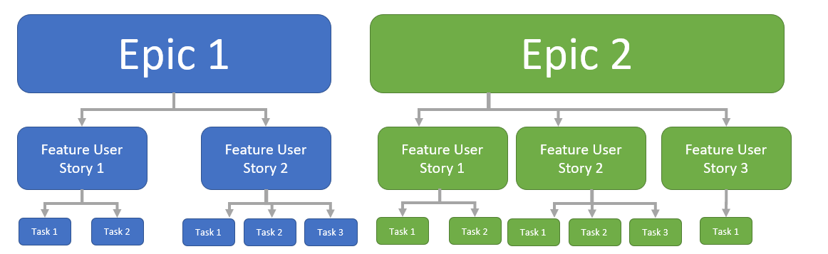
User stories in planning
Product backlog as user stories
Focus on implementable unit
Managing complex feature
Notes:
Product Backlog as User Stories: In Scrum, the product backlog is typically represented as a collection of user stories. This format helps to ensure that every backlog item focuses on delivering specific value to the user, aligning development efforts directly with user needs.
Focus on Implementable Units: User stories should be concise and focused on a clearly defined system feature or aspect of a feature. Ideally, each story should be scoped to be implementable within a single sprint, facilitating rapid development and frequent reassessment.
Managing Complex Features: For more complex features that cannot be completed within a single sprint, user stories are classified as epics. An epic is a large user story that is expected to be broken down into smaller stories, each of which can be completed within a sprint.

Slide 21
Example: System backup and restoration
Epic:
  As a system manager, I need a way to backup the system and restore either individual applications, files, directories, or the whole system.
Stories:
  As a system manager, I want to backup individual files, so that I can easily restore them if they are lost or corrupted.
  As a system manager, I want to restore individual applications quickly, ensuring minimal downtime in case of application failure.
  As a system manager, I need the ability to perform full system backups weekly, to ensure comprehensive data protection.

Slide 22
User stories describing the group feature
Notes:
Stories can be used to describe features in your product that should be implemented.
Each feature can have a set of associated stories that describe how that feature is used.

Slide 23
Feature Derivation
Features can be identified directly from the product vision or from scenarios.
You can highlight phrases in Scenario
  You should think about the features needed to support user actions, identified by active verbs, such as use and choose.

Slide 24
Product Vision
Product Vision Statement (Using Moore’s Template):
  For university students and faculty - who need a flexible and interactive platform to manage coursework and enhance learning experiences - the AcademiaHub is a web-based learning management system - that offers personalized learning paths and real-time collaboration tools - unlike traditional one-size-fits-all educational platforms - our product tailors learning experiences to personalized and individual academic needs and fosters active learning through collaboration.

Slide 25
Derived Features from Product Vision
Personalized Learning Paths: Allows users to create and follow customized learning journeys based on their academic goals and interests.
Real-Time Collaboration Tools: Provides features like shared whiteboards, real-time document editing, and video conferencing to support interactive learning.
Adaptive Learning Analytics: Integrates machine learning to analyze student performance and adjust content delivery to optimize learning outcomes.

Slide 26
Scenario
Scenario: Professor Smith wants to use an online platform to coordinate a semester-long project involving multiple groups of students, tracking their progress, scheduling milestones, and providing targeted feedback based on individual and group performance.

Slide 27
Derived Features from Scenario
Group Management Interface: Tools for creating student groups, assigning roles, and managing memberships.
Project Tracking Dashboard: A comprehensive dashboard that allows tracking of project milestones, submission deadlines, and overall progress for each group.
Feedback System: Features enabling Professor Smith to provide individualized feedback and grade submissions, with support for audio and text comments.

Slide 28
Feature List
The output of the feature identification process should be a list of features that you use for designing and implementing your product.
There is no need to go into a lot of detail about the features at this stage. You add detail when you are implementing the feature.
You can describe features using a standard input-action-output template by using structured narrative descriptions or by a set of user stories.

Slide 29
Authentication Feature example

Slide 30
Feature Example: Group Management Interface
Description:
  The Group Management Interface allows instructors to create, modify, and manage student groups within online courses. This feature includes tools for assigning roles, setting permissions, and tracking group membership changes over time. It aims to facilitate seamless collaboration among students by organizing them into structured groups, which can be tailored to various project types and class activities.

Slide 31
Feature Example: Group Management Interface
Constraints:
  User Roles: Only users identified as "Instructors" or "Teaching Assistants" have the authority to create and manage groups. Students can view group memberships but cannot alter them.
  Scalability: The interface must efficiently handle classes of varying sizes, from small seminars to large lectures with hundreds of students, without performance issues.
  Integration: This feature must integrate smoothly with other platform components like the Project Tracking Dashboard and Real-Time Collaboration Tools without disrupting existing functionalities.
  Data Privacy: Must comply with educational data privacy regulations (e.g., FERPA in the U.S.) to protect student information.

Slide 32
Innovation and feature identification
Scenarios and user stories should always be your starting point for identifying product features.
  Scenarios tell you how users work at the moment. They don’t show how they might change their way of working if they had the right software to support them.
  Stories and scenarios are ‘tools for thinking’ and they help you gain an understanding of how your software might be used. You can identify a feature set from stories and scenarios.
User research, on its own, rarely helps you innovate and invent new ways of working.
You should also think creatively about alternative or additional features that help users to work more efficiently or to do things differently.

Slide 33
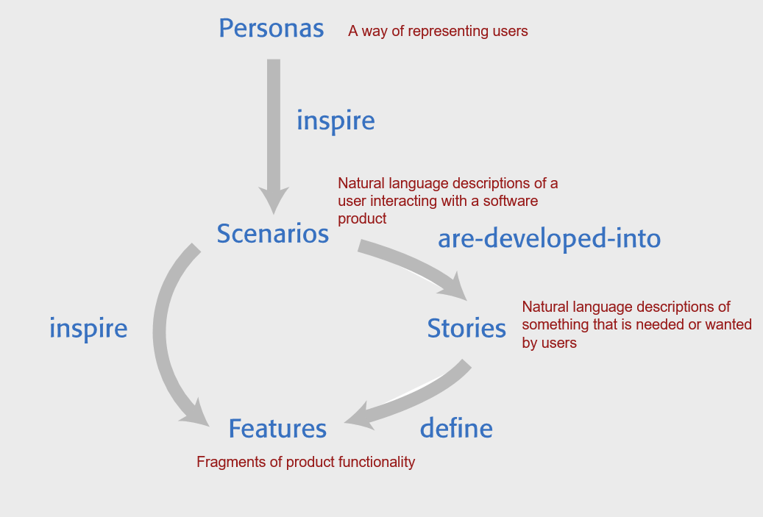
From personas, to Scenarios, Features and Stories

Slide 34
Takeaways!
A software product feature is a fragment of functionality that implements something that a user may need or want when using the product.
The first stage of product development is to identify the list of product features in which you identify each feature and give a brief description of its functionality.
Personas are ‘imagined users’ where you create a character portrait of a type of user that you think might use your product.
A persona description should ‘paint a picture’ of a typical product user. It should describe their educational background, technology experience and why they might want to use your product.
A scenario is a narrative that describes a situation where a user is accessing product features to do something that they want to do.

Slide 35
Takeaways!
Scenarios should always be written from the user’s perspective and should be based on identified personas or real users.
User stories are finer-grain narratives that set out, in a structured way, something that a user wants from a software system.
User stories may be used as a way of extending and adding detail to a scenario or as part of the description of system features.
The key influences in feature identification and design are user research, domain knowledge, product knowledge, and technology knowledge.
You can identify features from scenarios and stories by highlighting user actions in these narratives and thinking about the features that you need to support these actions.

Slide 36
More Examples

Slide 37
Emma’s Scenario
Emma’s scenario is different from Jack’s scenario in that it describes a common and well-understood process rather than something new.
Emma is an e-learning sceptic, and she is not interested in innovative applications. She wants a system that will make her life easier and reduce the amount of routine administration that she has to do.
The scenario discusses how parts of the process (setting up an email group and web page) are automated by the iLearn system.

Slide 38
Emma’s scenario: Using iLearn for administration
She names the group and confirms that it should be created. The app sets up an icon on her iLearn screen to represent the group, creates an email alias for the group and asks Emma if she wishes to share the group. She shares access with everyone in the group, which means that they also see the icon on their screen. To avoid getting too many emails from students, restricts sharing of the email alias to Jamie and Claire.
The group management app then asksEmma if she wishes to set up a group web page, wiki and blog. Emma confirms that a web page should be created and she types some text to be included on that page.
She then accesses flickr using the icon on her screen, logs in and creates a private group to share trip photos that students and teachers have taken. She uploads some of her own photos from previous trips and emails an invitation to join the photo-sharing group to the Battlefield email list. Emma uploads material from her own laptop that she has written about the trip to iLearn and shares this with the ‘Battlefields Group’. This action adds her documents to the web page and generates an alert to group members that new material is available.

Slide 39
Emma’s scenario: Using iLearn for administration
Emma is teaching the history of the First World War to a class of 14 year olds (S3). A group of S3 students are visiting the historic World War One battlefields in northern France. She want to set up a ‘battlefields group’ where the students who are attending the trip can share their research about the places they are visiting as well as their pictures and thoughts about the visit.
From home, she logs onto the iLearn system system using her Google account credentials. Emma has two iLearn accounts – her teacher account and a parent account associated with the local primary school. The system recognises that she is a multiple account owner and asks her to select the account to be used. She chooses the teacher account and the system generates her personal welcome screen. As well as her selected applications, this also shows management apps that help teachers create and manage student groups.
Emma selects the ‘group management’ app, which recognizes her role and school from her identity information and creates a new group. The system prompts for the class year (S3) and subject (history) and automatically populates the new group with all S3 students who are studying history. She selects those students going on the trip and adds her teacher colleagues, Jamie and Claire, to the group.

Slide 40
Figure 3.6 User stories from Emma’s scenario

